Slide 1
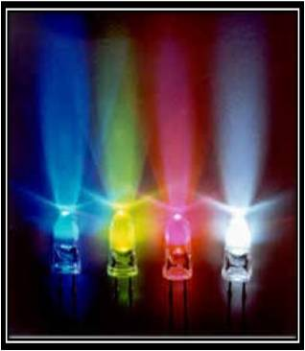
GaN Based Cyan Light-Emitting Diodes with GHz Bandwidth
Speaker: Prof. Jin-Wei Shi

Slide 2
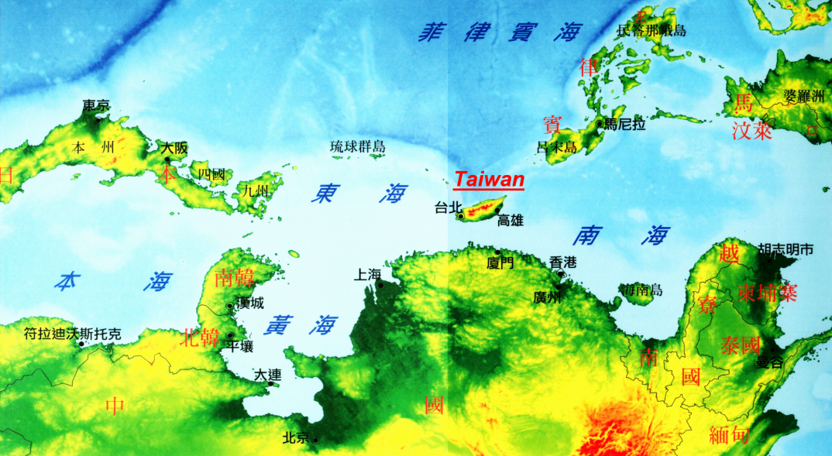

National Central University

Slide 3



Collaborators
Prof. J. K. Sheu
(許進恭)
微光電實驗室
Prof. John E. Bowers

Slide 4
Outline
Motivation
Internal: Active Layer Design (Thin barrier)
External: Miniaturized LED on PS Substrate
Measurement Results
Conclusion

Slide 5
Outline
Motivation
Internal: Active Layer Design (Thin barrier)
External: Miniaturized LED on PS Substrate
Measurement Results
Conclusion

Slide 6
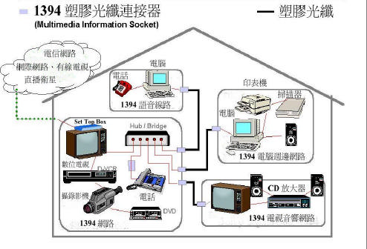
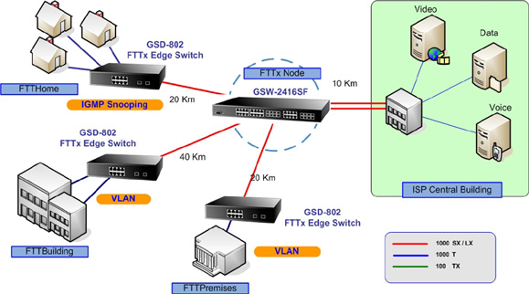
Motivation
POF Communication
POF-ALL: The users can afford the super high speed internet engineer
Fiber To The Home Fiber To The Room(Desk)
Notes:
以往塑膠光纖(POF)的訊號損失很大，但因應光纖到桌與區域網路的需求快速增加，以及塑膠光纖便宜的價格、可撓性佳等優點，使塑膠光纖 在通訊傳輸上一直被研究著，直到訊號損失上有所改良，近年來更是突破，讓塑膠光纖可得到更大的應用與普及。

Slide 7

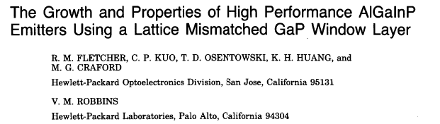
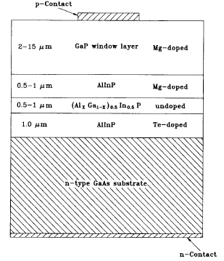
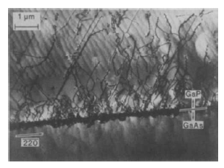
The Beginning of Red for POF: at USA (HP Company)
Demand (at ~1980s’): For In-car data communication (to avoid the interference from engine and electrical power generator)
Solution from HP (for Ford) : Red RCLED + PMMA POF
No good green light source during that time

Slide 8
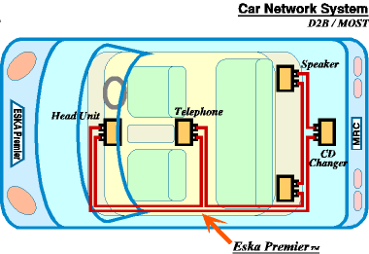
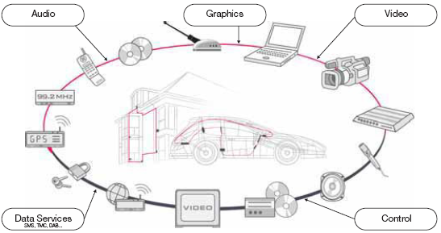
Motivation
High-power and high-speed optical source at the green wavelength regime(~525nm) are useful for a wealth of application.
POF (Plastic Optic Fiber) Communication
The MOST (Media Oriented Systems Transport ) Cooperation was founded in 1998 to standardize MOST Technology as a global standard for multimedia networking.
But POF faces strong challenge from coaxial cable at 1 Gbit/sec data rate…

Slide 9
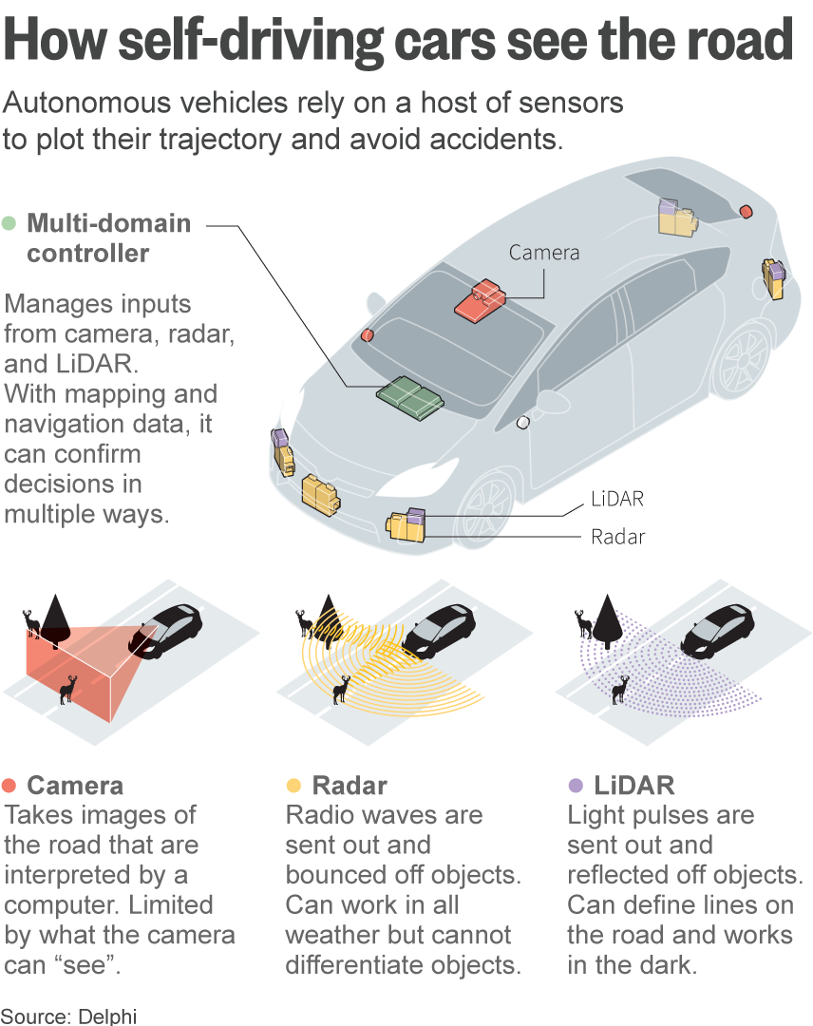
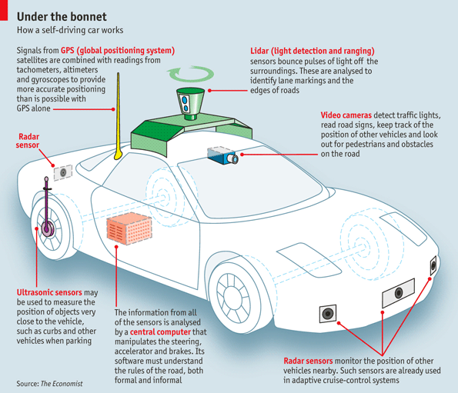
Self-Driving Car… To rescue POF ?
You need a lot of bandwidth (10 Gbit/sec ?!) for in-car data communication: The chance of POF…
Much tough than glass fiber: Car accident is an issue

Slide 10

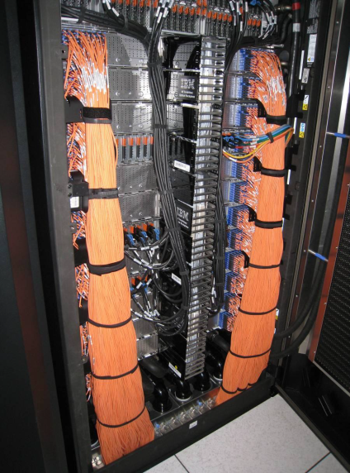
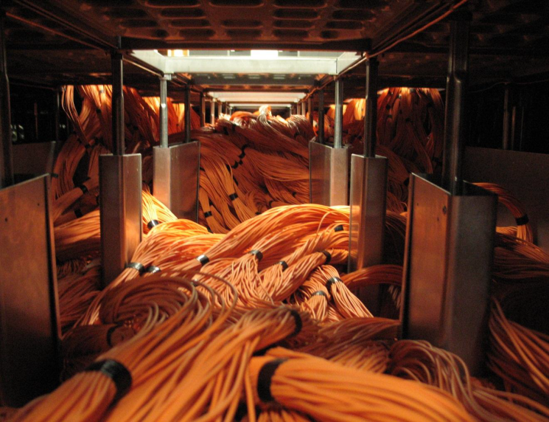

Another reason for POF based network: Light EV car…
Coaxial cable vs. fiber !! (in data center)
This is necessary for EV car….
You need a fiber based network instead of
bulky coaxial cable for your EV car !!

Slide 11
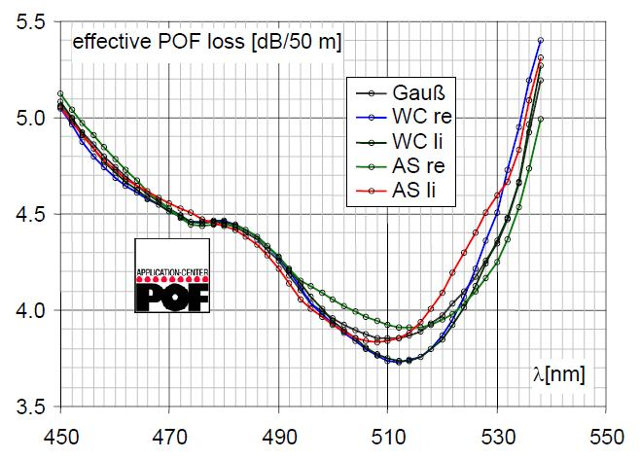
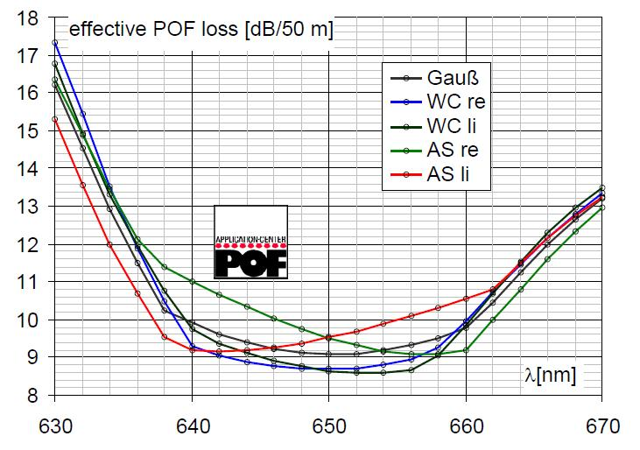
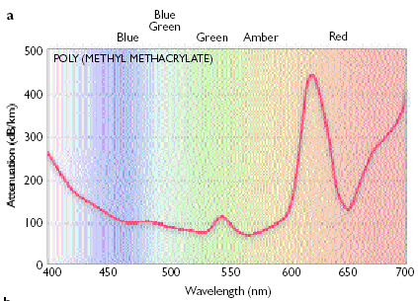
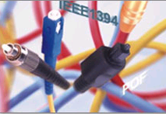
What wavelength you prefer for PMMA POF ?
(methyl methacrylate) POF
Step Index PMMA POF
Green is better than red.
However no good green light source (GaN based) till ~2000 years
The windows at 520 and 570 nm are broader and, thus, less sensitive to shifts in source wavelength resulting from temperature changes.
125 dB/km@650nm
90 dB/km@520nm and 570nm
Provided by Prof. Olaf Ziemann, Polymer Optical Fiber Application Center, POF-AC
Georg-Simon-Ohm Fachhochschule Nürnberg
Wassertorstr. 10, 90489 Nürnberg.

Slide 12
Why we want switch red to green (or blue) ? (not only lower POF loss…..)
The power performance of red RCLED is sensitively to the variation of ambient temperature.
T
T
Good!!
AlGaAs/GaAs
InGaN/GaN

Slide 13
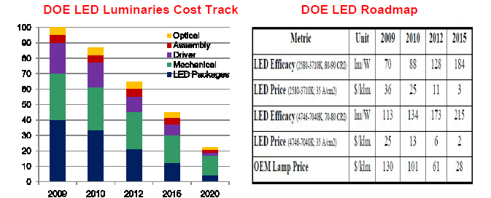
Why we want switch red to green (or blue) ? (not only lower POF loss…..)
To further reduce the cost of POF Tx/Rx Chips
The cost of III-nitride based LED chip becomes lower and lower………..(Eventually beats the cost of red RCLED…..)

Slide 14
Outline
Motivation
Internal: Active Layer Design (Thin barrier)
External: Miniaturized LED on PS Substrate
Measurement Results
Conclusion

Slide 15
LED modulation characteristics
There are two major limiting factors of modulation-speed of LED
Spontaneous lifetime
1
P-type
MQW
RC Delay
N-type
2
In communication LEDs , the current-injected active region is much smaller, so that the spontaneous lifetime rather than the diode
capacitance limits the maximum modulation frequency

Slide 16
What’s the problem of GaN MQWs ?
MQW without barrier doping
MQW with barrier doping
Wave function overlapping
Wave function overlapping
The better material quality in the interface between well and barrier, screening of piezoelectric field, higher of electron/hole wave function
overlapping in the well region

Slide 17
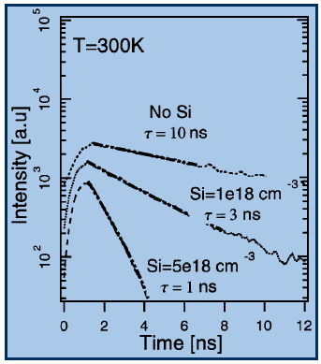

How to shorten spontaneous lifetime? Barrier n-doping
Room temperature intensity at the peak wavelength is shown as a function of the Si doping level in MQW barriers
Higher Si barrier doping
induced lower carrier
lifetime
P-type
Si dopping barrier
MQW
N-type
Milan S. Minsky, Shigefusa Chichibu,Siegfried B. Fleischer, Amber C. Abare, John E. Bowers,“Optical Properties of InGaN/GaN Quantum Wells with Si Doped Barriers ” Jpn. J. Appl. Phys., vol. 37, pp. 1362-1364, Mar. , 1998.

Slide 18
How to enhance spontaneous recombination rate ?
Solution: To thin down active layer width and barrier width !!
P
GaN/InGaN
MQWs
N Substrate
Parasitic MQW
P-type
N-type
Thin active layer: increase injected current density (R_{sp} )
Thin barrier: uniform hole distribution !!
piezoelectric field
Extremely small hole mobility

Slide 19
Thin Active layer with thin barrier
Our new structure
Reference structure
P⁺-GaN; 30 nm
P⁺-GaN; 30 nm
V
V
P-GaN; 130 nm
P-GaN; 130 nm
p- Al_{x}Ga_{1-x}N; 50nm
p- Al_{x}Ga_{1-x}N; 50nm
Undoped MQWX4
4 pair InGaN/GaN MQW(Barrier:170 Å; Well: 30 Å)
37nm
Barrier:50 Å;Well: 30 Å
97 nm
Good!!
2 pair Si doping in barrier layer
n⁺ -GaN; 3 μm
V
u- GaN; 1 μm
N-GaN+u-GaN+n-AlGaN
n- Al_{x}Ga_{1-x}N; 50nm
Patterned Sapphire
Patterned Sapphire
Increase the injected carrier density.
Shorten the spontaneous recombination time.
Uniform the hole distribution

Slide 20
Simulated Carrier Distribution
in Active Layers
Thick Barrier !!
Thin Barrier !!
Thin Barrier would provide you a higher R_{sp} (Faster response time)
No parasitic MQWs

Slide 21
Outline
Motivation
Internal: Active Layer Design (Thin barrier)
External: Miniaturized LED on PS Substrate
Measurement Results
Conclusion

Slide 22
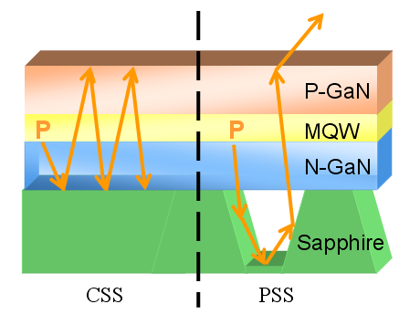
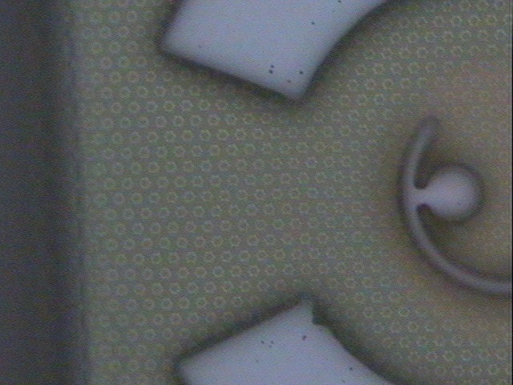
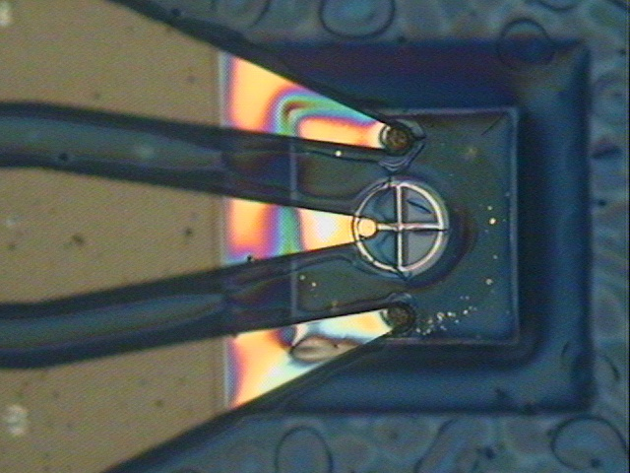
Device structure
97 nm
9µm
2µm
Enhance the output light extraction efficiency.
Improve the quality of epi-layer structure.
¹J.-W. Shi, H.-W. Huang, F.-M. Kuo, J.-K. Sheu, W.-C. Lai, M. L. Lee, “Very-High Temperature (200℃) and High-Speed Operation of Cascade GaN Based Green Light Emitting Diodes with an InGaN Insertion Layer,” IEEE Photon. Technol. Lett., vol. 22, pp. 1033-1035, July, 2010.

Slide 23
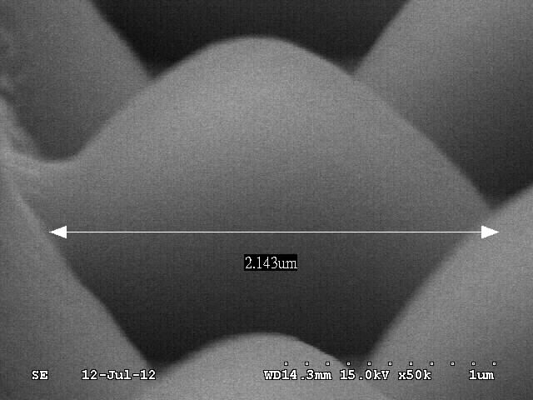
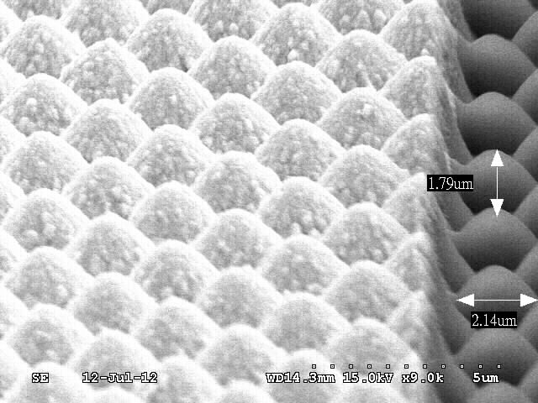
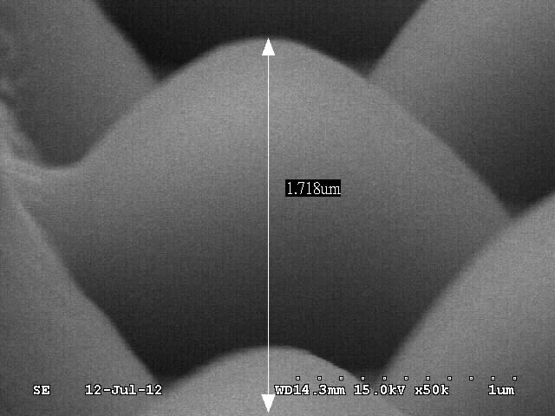
Patterned Sapphire(by SEM)
SEM

Slide 24
Device structure
P⁺-GaN; 30 nm
V
P-GaN; 130 nm
p- Al_{x}Ga_{1-x}N; 50nm
Undoped MQWX4
Thinner active layer (Barrier)
Barrier:50 Å;Well: 30 Å
n⁺ -GaN; 3 μm
V
u- GaN; 1 μm
n- Al_{x}Ga_{1-x}N; 50nm
Patterned Sapphire Substrate (PSS)
Patterned Sapphire
Enhance the output power from LED for data transmission.
Enhance current modulation efficiency.

Slide 25
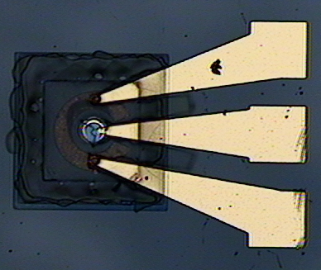
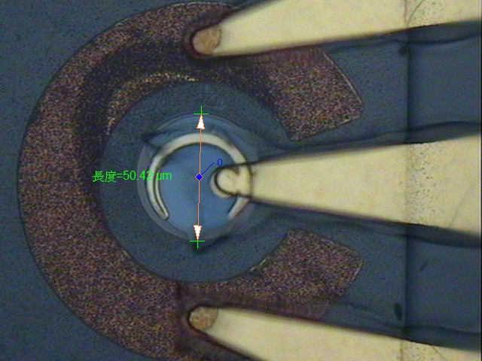
Device structure
Our fast LED device top view.

Slide 26
Outline
Motivation
Internal: Active Layer Design (Thin barrier)
External: Miniaturized LED on PS Substrate
Measurement Results
Conclusion

Slide 27
Static Measurement Results: EL Spectra
Both Devices have a close value of EL peak (~470 nm)
The spectral width of thin barrier device is “narrower” than that of thick barrier (37 vs. 41 nm @ 50 mA)
Less dispersion !!
Notes:
圖為串接式綠光發光二極體頻寬速度的表現(直徑100um)
在量測中我們改良了往年所設計的元件距離，因塑膠光纖的直徑為1mm，將元件距離縮至1mm以內，這將對於耦光功率有良好的幫助。
量測結果可知三顆串接式綠光發光二極體有較大的發光主動區和輸出功率，但串接式發光二極體仍有非常相似於一顆發光二極體的速度特性，
這是有低的微分電阻和因串接而減少的總接面電容，且我們的元件頻寬在操作電流100mA下約達到200MHz，
另外在汽車特殊規格12V驅動電壓下，Device A頻寬約100MHz ，Device B頻寬約40MHz，這可歸究於Device A的結構加入了InGaN插入層，增強了
元件的靜態特性，使元件的I-V特性在定電壓下提供較大的載子密度在MQW中，有效的降低spontaneous recombination time.

Slide 28
Static Measurement Results: L-I-V curves
Thick Barrier
Thin Barrier
(a)
(b)
19%
20%
Devices A-C: Thick barrier
Devices D-F: Thin Barrier
Thin Barrier has slightly better L-I-V than that of thick barrier: Higher power with less thermal degradation
Notes:
圖為串接式綠光發光二極體頻寬速度的表現(直徑100um)
在量測中我們改良了往年所設計的元件距離，因塑膠光纖的直徑為1mm，將元件距離縮至1mm以內，這將對於耦光功率有良好的幫助。
量測結果可知三顆串接式綠光發光二極體有較大的發光主動區和輸出功率，但串接式發光二極體仍有非常相似於一顆發光二極體的速度特性，
這是有低的微分電阻和因串接而減少的總接面電容，且我們的元件頻寬在操作電流100mA下約達到200MHz，
另外在汽車特殊規格12V驅動電壓下，Device A頻寬約100MHz ，Device B頻寬約40MHz，這可歸究於Device A的結構加入了InGaN插入層，增強了
元件的靜態特性，使元件的I-V特性在定電壓下提供較大的載子密度在MQW中，有效的降低spontaneous recombination time.

Slide 29
Speed Measurement Results: E-O Response
Thick Barrier
Thin Barrier
(a)
(b)
Higher R_{sp} in thin barrier device: Faster speed performance (0.96 vs. 0.89 GHz)
“Record high 3-dB O-E bandwidth among all visible LEDs”

Slide 30
Speed Measurement Results: E-O Response
Thick Barrier
Thin Barrier
(a)
(b)
Thin barrier device still has superior speed performance to thick barrier device at elevated temperature !! (110 degree C)

Slide 31
Outline
Motivation
Internal: Active Layer Design (Thin barrier)
External: Miniaturized LED on PS Substrate
Measurement Results
Conclusion

Slide 32
Conclusion
Lower and lower cost of GaN LED should drive us to replace red RCLED for POF communication due to its superior high-T performance
Thin GaN barrier layers really works to improve speed and power performance of LED
Record high (~1 GHz) 3-dB O-E bandwidth among all visible LEDs have been demonstrated

Slide 33
Thank you for your attention

